Slide 1
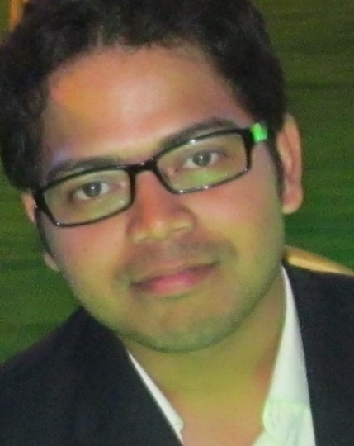
Akash Pal– DevOps Lead
Skills & Projects
Executive Summary
Programming Languages:
Core Java, ASP.NET.
Dev Tool:
Visual Studio, Eclipse, Netbeans, IntelliJ, RTC SCM tools etc.
Other tools:
Jenkins, GIT, Sonar Qube, Docker container and Jenkinscloudbees.
Projects:
Marketplace and Telemetry build and release Implementation
EY-ATF-(Audit tools for future)
Citi GPA- Global Product assurance- Application Lifecycle management.
Citi CATE for build and deployment management.
Internal JPlus repository maintenance
5 years of experience in IT analysis, consulting, implementation, maintenance and development for Application Lifecycle management.
A Microsoft certified professional and Jenkins engineer.
Microsoft Certified Solutions Developer in Application Lifecycle Management which includes Administering TFS, software testing with MTM and continuous delivery using Visual Studio ALM.
Technical expertise in all aspects of the SDLC (Waterfall, Scrum and Agile).
Hands on experience in Banking and Finance, Insurance, Transportation domains.
Proficiency in managing and build an application from its requirement to release process.
Strong adaptive approach to follow new technologies and enhancement in existing ones with cognitive flexibility.
In current role, I am working as a DevOps Lead.
Name
Akash Pal
akash.pal@cognizant.com
Relevant Experience Summary
Email
Experienced in VSTFS Architecting, Set up and Implementation.
Experienced in upgrading TFS to later versions with all its configuration and securities.
Experienced in Microsoft Azure: Design and Implement Web Apps (Hosting web applications on azure platform), Create and manage Virtual, Implementing Custom Domain, Design and Implement Storage strategy, Managing application and network services.
Rich experience in Microsoft and IBM build tools like Rational Team Concert and Tasktop.
Experience in defining and implementing solutions to business Platforms.
Tools/Tech : Microsoft Team Foundation Server, IBM Rational Team Concert, Jenkins, Collabnet Team Forge, Microsoft Visual Studio, Thor Enterprise Build, IBM Tasktop, IBM AppScan, Eclipse, Sonar Qube, SCM tools, Putty, Tectia, Service Now, WinSCP, SSMS, Team Project Management (TFS 2010, TFS 2012, TFS 2013, TFS2015, TFS2017)
Deployment : Azure, IIS, RLM, Docker and AWS.
Others: Knowledge on Jenkins, Altassian products, HPQC ALM for defect management.

